Slide 1
Agricultural
Services
Sasitaporn Wongphab 593040680-3
Gidsadaporn Karob 593040654-4
Group 14
1

Slide 2
Motivation
“
In the rush hour, busy schedule problems. Do not know the contractor's schedule. Difficult to coordinate. And the contractor has a schedule that is unclear, may cause a schedule of collisions. Calculate the area and calculate the wage, which may not be calculated correctly. No customer records.
“
2

Slide 3
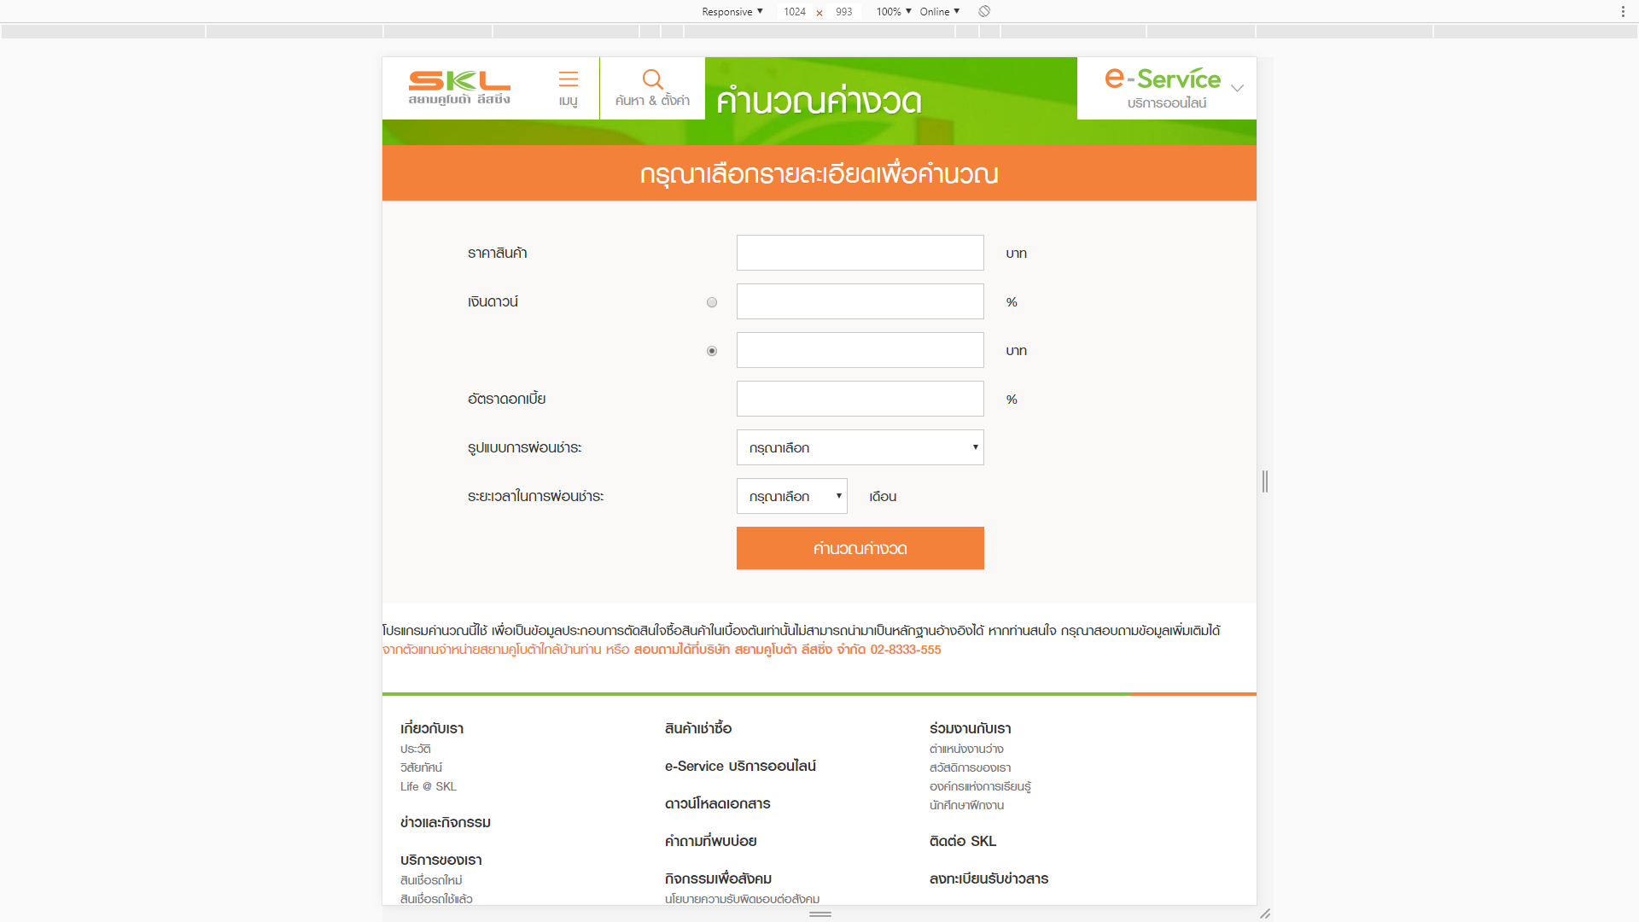
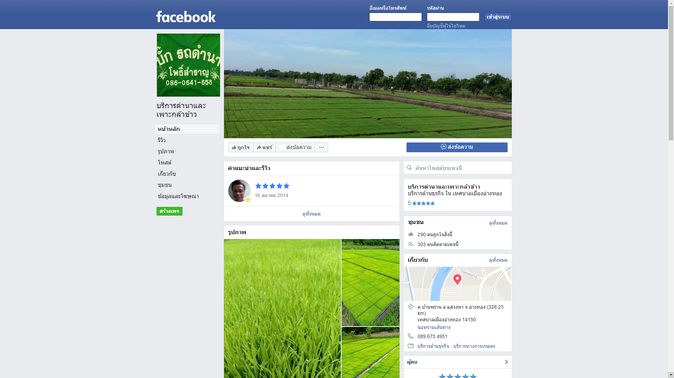
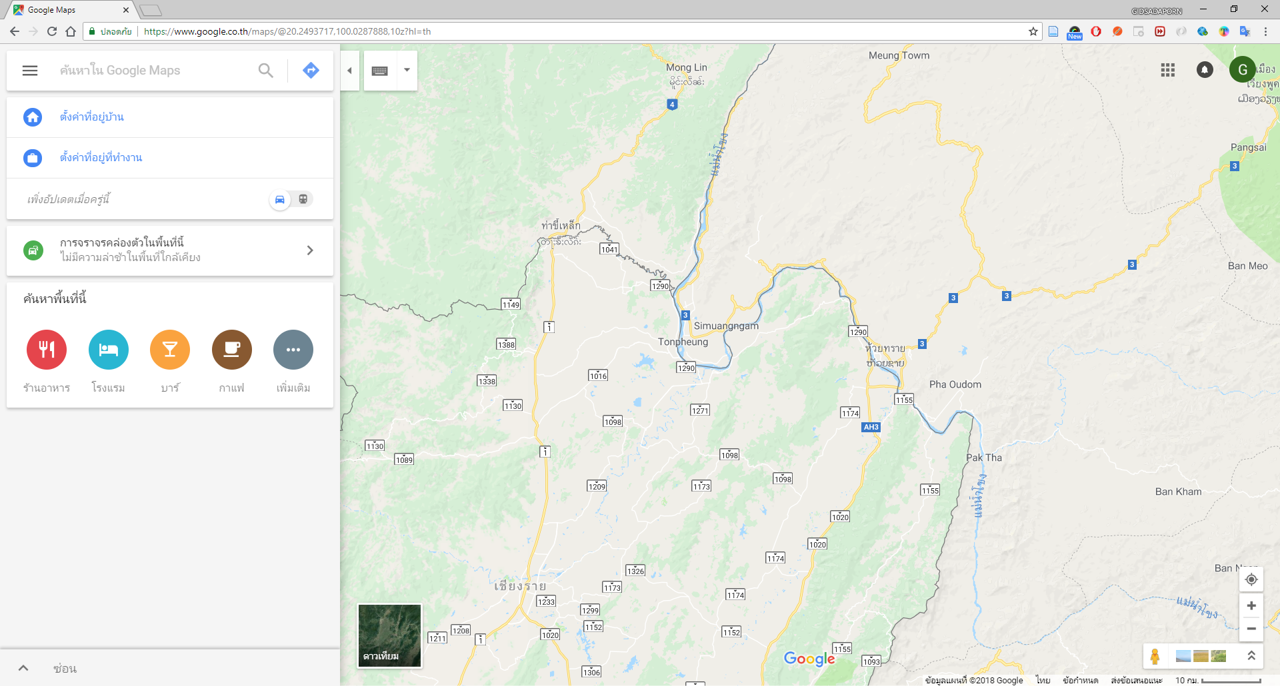
Related Work
FB
KSL
MAP
3

Slide 4
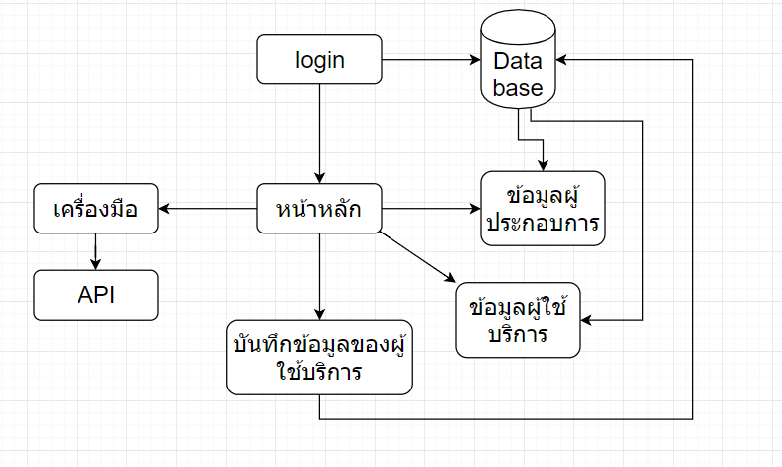
Software Architecture & Methodology
4

Slide 5
Main function
5

Slide 6
API
01
Google map
04
Calendar
02
PTTInfo
05
Facebook for developers
03
TMDAPI
6

Slide 7
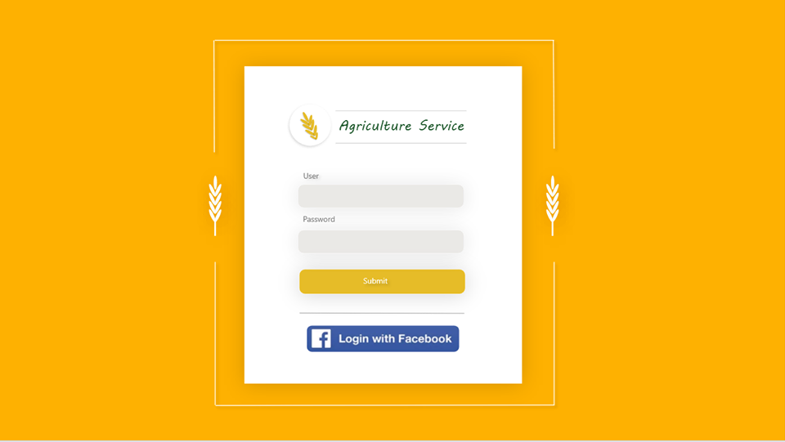
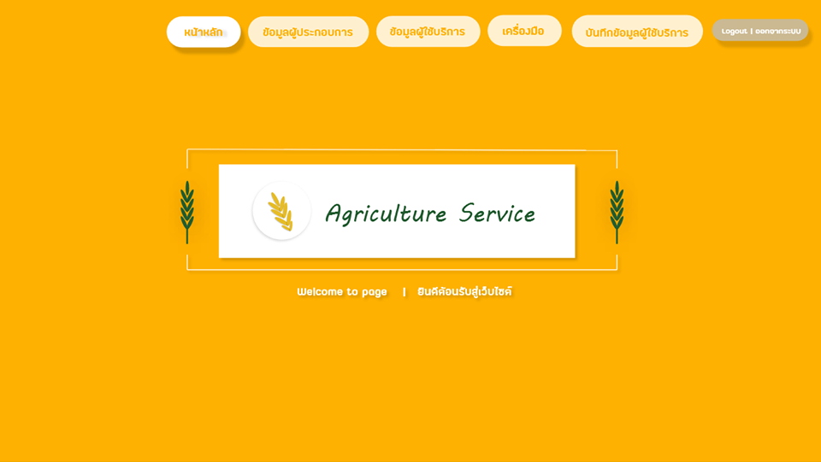
Prototype
Login
Home
.
.
7

Slide 8
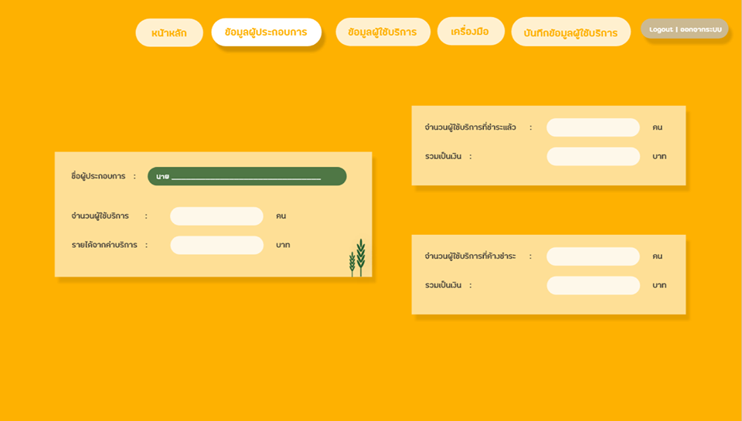
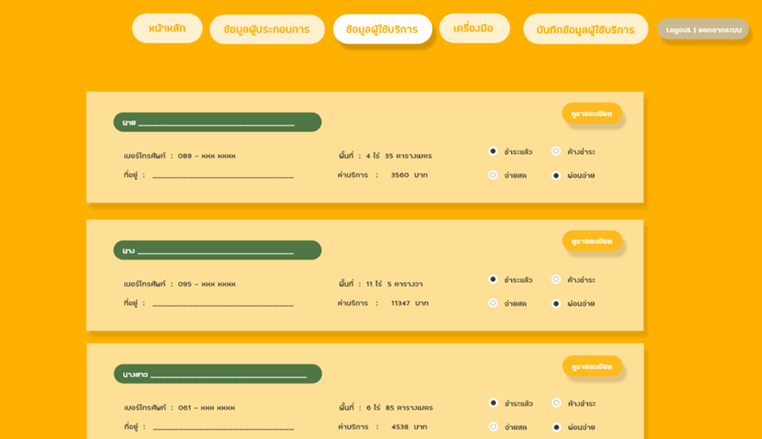
Prototype
user data
customer data
.
.
8

Slide 9
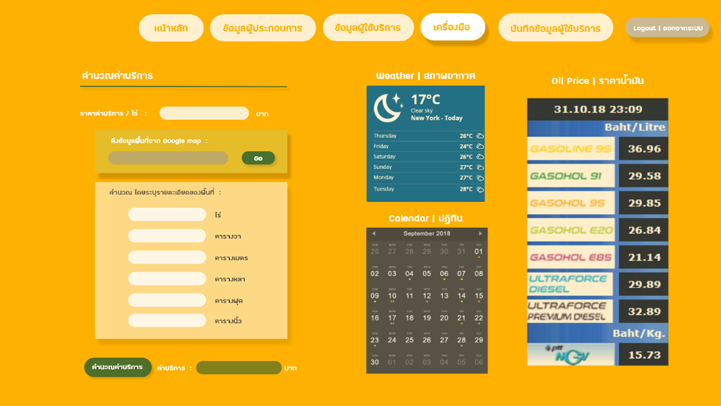
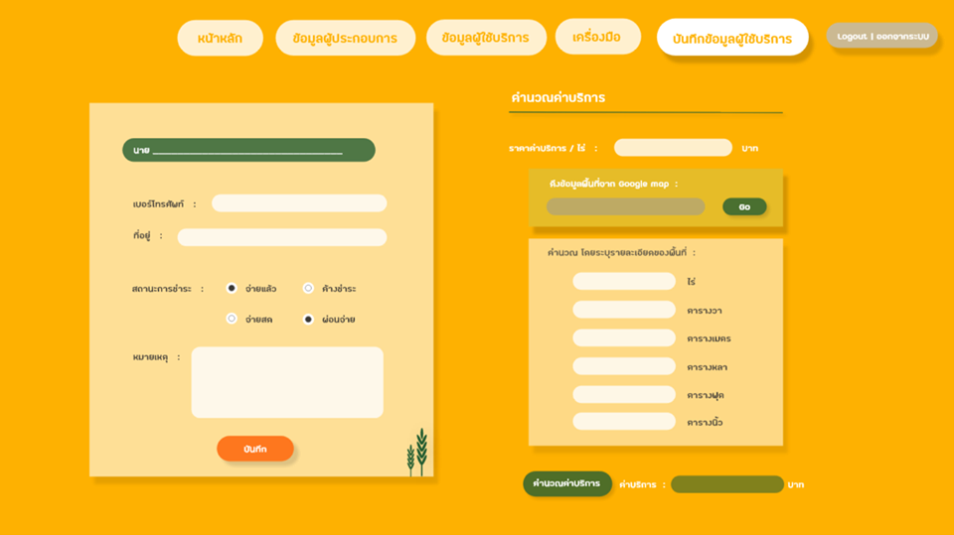
Prototype
Tool
Add data
.
.
9

Slide 10
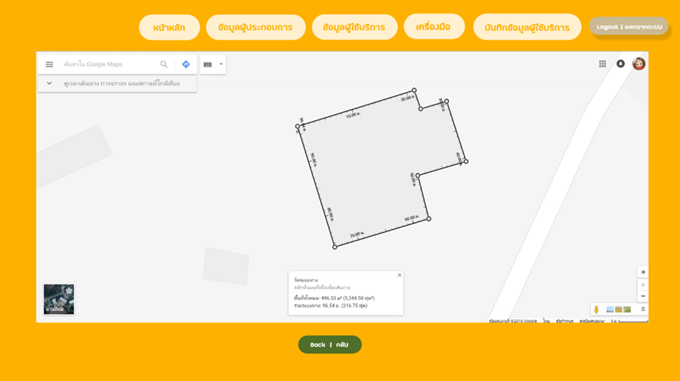
Prototype
MAP
.
10

Slide 11
Problem
11

Slide 12
Progress & Timeline & Future Work
12

Slide 13
Operating procedures | 3-16 Sep | 17-30 Sep | 1-31 Oct | 1-11 Nov | 12- Nov
1. Layout design and plan the implementation
2. Learn the information related to web application
3. Develop web application
4. Test and fix web application
5. Analyze conclude and present
Learn the information related to web application
13

Slide 14
Thank you

